Slide 2

18ECC303J – Computer Communication Networks
Course Credit : 4
Theory : 9 Hours
Reference Text Books
1.Behrouz A. Fehrouzan, “Data communication & Networking”, Mc-Graw Hill, 5th Edition Reprint, 2014.
2. Andrew S. Tanenbaum, “Computer Networks”, Pearson Education India, 5th Edition, 2013.
3. William Stallings, “Data & Computer Communication”, Pearson Education India, 10th Edition, 2014.

Slide 3
Unit 3 – Network Layer
Session 1
Introduction to Network Layer
Need for Internetworking
Session 2
Addressing-Classful
Session 3
Addressing-Classless
Session 6
Network Layer Protocol-IPV4
Session 7
Internet Protocol(IP)-IPV6
Session 8
Session 11
Routing Protocols- Distance Vector& Link State
Routing Issues-Delivery, Forwarding and Routing
Routing Information Protocol-RIP
Session 12
Open Shortest Path First-OSPF
Session 13
Border Gateway Protocol-BGP
Week 7
Week 8
Week 9

Slide 4

Objectives
Upon completion you will be able to:
Recall the Fundamentals of Network layer, its services
Understand the concept of Internetworking and its need
Understand IPv4 addresses and classes
Identify the class of an IP address
Find the network address given an IP address
Understand masks and how to use them
Understand subnets and supernets

Slide 5
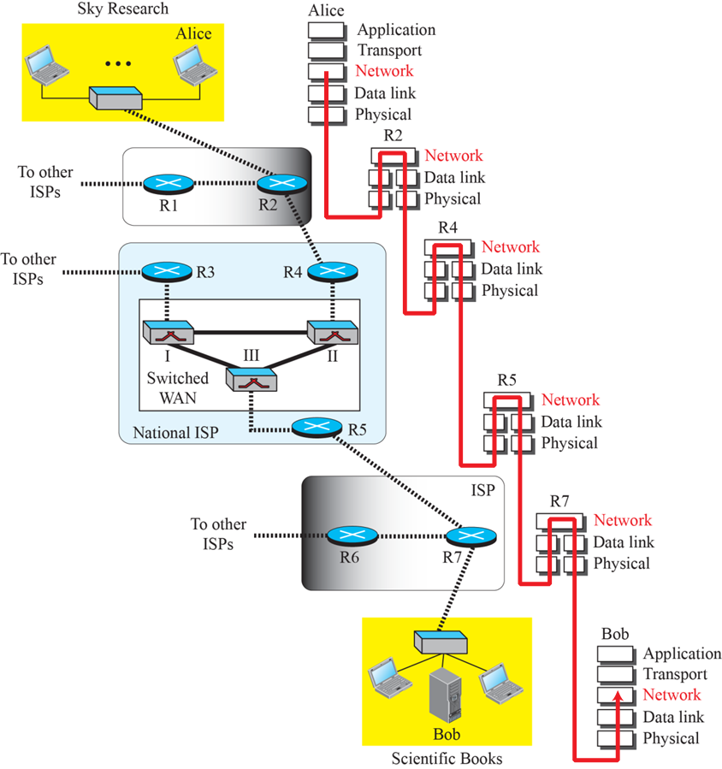
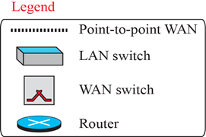
Session 1- Introduction Network Layer
Network layer is responsible for the host- to- host delivery of datagram.
It provides services to the transport layer and receives services from data link layer.
The network layer is involved at the source host, destination host, and all routers in the path(R2, R4, R5, and R7).
At the source host (Alice), the network layer accepts a packet from a transport layer, encapsulates the packet in a datagram, and delivers the packet to the data-link layer.
At the destination host (Bob), the datagram is decapsulated, and the packet is extracted and delivered to the corresponding transport layer.
The routers use three layers if they are routing packets only; however, they may need the transport and application layers for control purposes.
A router in the path is normally shown with two data-link layers and two physical layers, because it receives a packet from one network and delivers it to another network.

Slide 6
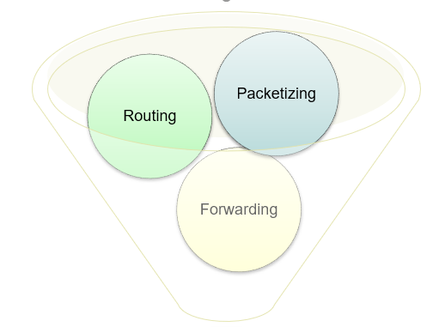

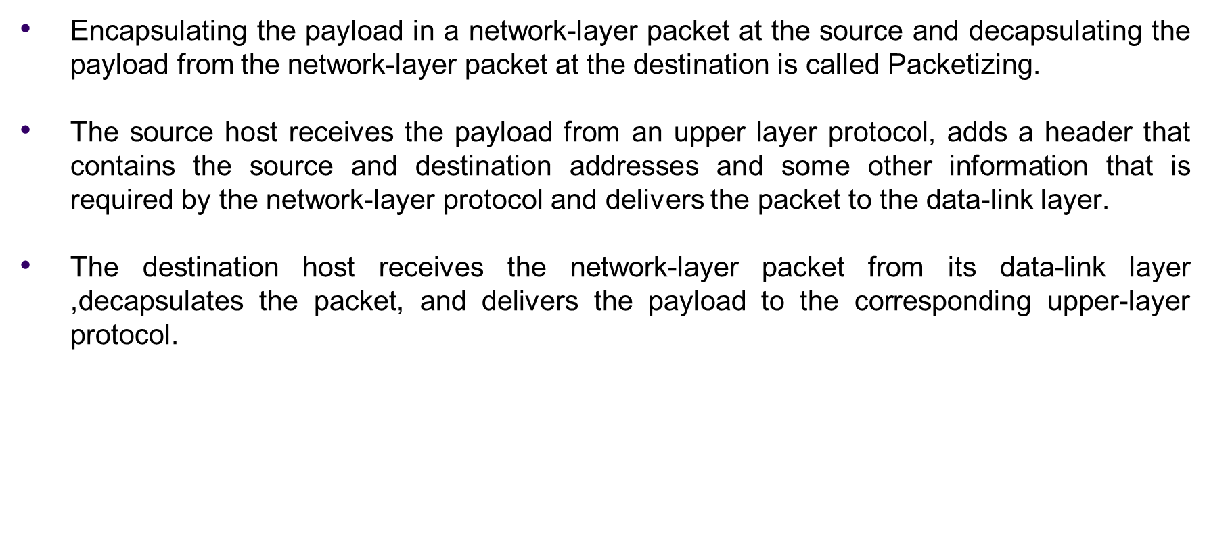
Layer Services

Slide 7
Review Question
Why does the network-layer protocol need to provide packetizing service to the transport layer?

Slide 8
Answer:
The network layer communication is between two hosts whereas it is between two ports in the transport layer.
This means that each layer has a different source/destination address pair; each layer needs a different header to accommodate these pair of addresses.

Slide 9
2. Routing:
A physical Network is a combination of LANs, WANs and routers that connect them. Therefore, there is more than one route from the source to the destination. The network layer is responsible for finding the best one among these possible routes that called routing.
The network layer have some specific strategies for defining the best route called routing protocols, routing protocols help the routers coordinate their knowledge about the neighborhood and to come up with consistent tables to be used when a packet arrives.

Slide 10
Review Question
Why is routing the responsibility of the network layer?

Slide 11
Answer:
It deals with the data transferring from one to another place
It is responsible for host to host (source to destination) packet delivery

Slide 12
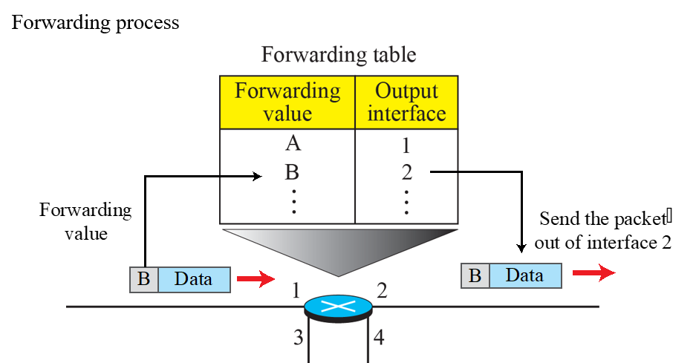
3. Forwarding
When a router receives a packet from one of its attached networks, it needs to forward the packet to another attached network.
forwarding can be defined as the action applied by each router when a packet arrives at one of its interfaces based on routing table.
To make this decision, router normally use a decision-making table . It is called (the forwarding table) or (the routing table).The piece of information can be destination address or a label

Slide 13
Other Services
Error Control: a checksum field to the datagram to control any change or corruption in the header, but not in the whole datagram.
Flow Control: Flow control regulates the amount of data a source can send without overwhelming the receiver. The network layer in the Internet does not directly provide any flow control. The datagrams are sent by the sender when they are ready.(Why flow control is not provided?)
Congestion Control: Congestion may occur if the number of datagrams sent by source computers is beyond the capacity of the network or routers. In this situation, some routers may drop some of the datagrams.
Quality of Service: quality of service has become more important in the Internet especially with multimedia communication. However, to keep the network layer untouched, these provisions are mostly implemented in the upper layer.
Security: To provide security for a connectionless network layer, we need to have another virtual level ( IPSec) that changes the connectionless service to a connection-oriented service.

Slide 14
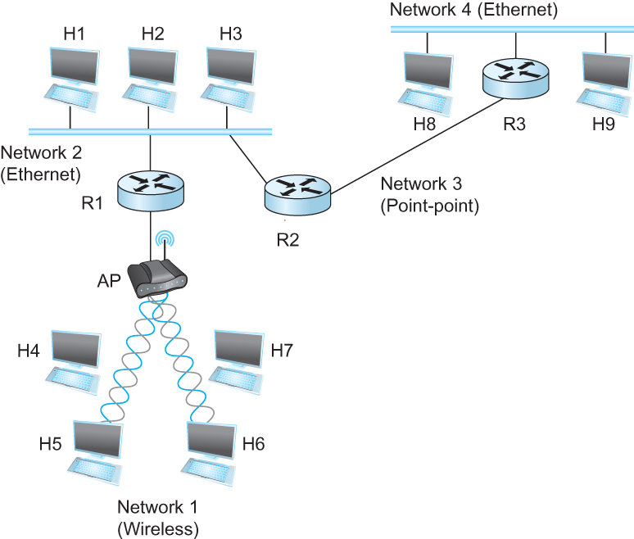
Need for Internetworking
What does Internetworking mean?
Internetworking is the process or technique of connecting different networks by using intermediary devices such as routers or gateway devices.
These arbitrary collection of networks are interconnected to provide some sort of host-to-host packet delivery service
Need of Internetworking
Internetworking ensures data communication among networks owned and operated by different entities using a common data communication and the Internet Routing Protocol.
Internetworking is only possible when all the connected networks use the same protocol stack or communication methodologies.
Notes:
Inter-network(internet)
A network of Network
Collection of networks
With different technology
Different physical characteristics
Different frame format
Different addressing schemes
Linked together by routers
That appears as a single system
Users connected to internet can communicate each other irrespective of the physical network
Internetworking protocol
Creates the internet abstraction
IP is the internetworking protocol for Internet

Slide 15
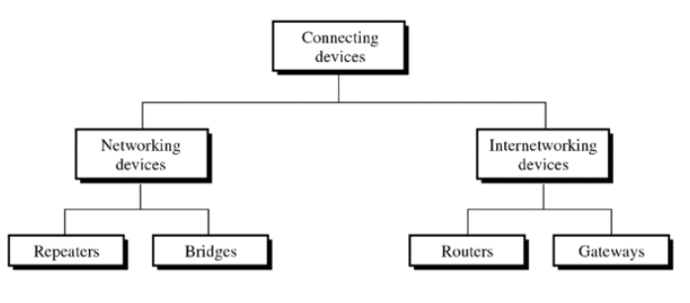
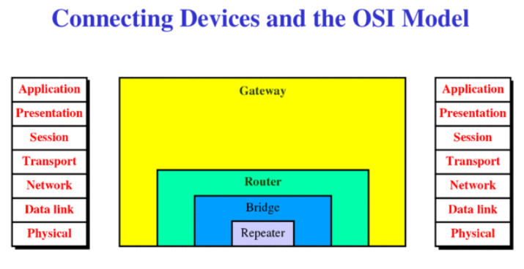
Internetworking devices
Internetworking Devices are the product used to connect networks.
As computer network grows in size and complexity, so do the internetworking devices used to connect them
Broadly. Following are the Internetworking Devices:
Repeater
Hubs
Bridges
Switches
Routers
Gateways
Networking Devices are used to connect within internal networks.
Internetworking devices are used to connect external networks.
An Internet is an interconnection of individual networks (Networks of networks)
Notes:
A repeater (or regenerator) is an electronic device that operates on only the physical layer of the OSI model.
A repeater installed on a link receives the signal before it becomes too weak or corrupted, regenerates the original pattern, and puts the refreshed copy back on the link.
A repeater does not actually connect two LANS; it connects two segments of the same LAN.
A repeater forwards every frame; it has no filtering capability.
A Hub is a multiport repeater. It is normally used to create connections between stations in a physical star topology.
Bridges operate in both the physical and the data link layers of the OSI model.
Bridges can divide a large network into smaller segments. They contain logic that allows them to keep the traffic on each segment separate. When a frame (or packet) enters a bridge, the bridge not only regenerates the signal but checks the destination address and forwards the new copy only to the segment the address belong.
A bridge has filtering capability
Routers operate in the physical, data link, and network layers of the OSI model.
Routers have access to network layer addresses and contain software that enables them to determine which of several possible paths between those addresses is the best for a particular transmission.
Routers relay packets among multiple interconnected networks. They route packets from one network to any of a number of potential destination networks on an internet.
Gateways operate in all seven layers of the OSI model.
A gateway is a protocol converter. A router by itself transfers, accepts, and relays packets only across networks using similar protocols.
A gateway can accept a packet formatted for one protocol (e.g. AppleTalk) and convert it to a packet for another protocol (e.g. TCP/IP).

Slide 16
Review Question
Which is called as two layer Switch?
Hub operates in which of the layer?
_______ does not actually connect two LANS, it connects two segment of the same LAN.
Which potentially operates in all seven layers?

Slide 17
Answer:
Bridges, Bridges operate in both the physical and the data link layers of the OSI model.
Hubs, A Hub is a multiport repeater. It is normally used to create connections between stations in a physical star topology.
Repeaters.
Gateways.

Slide 18
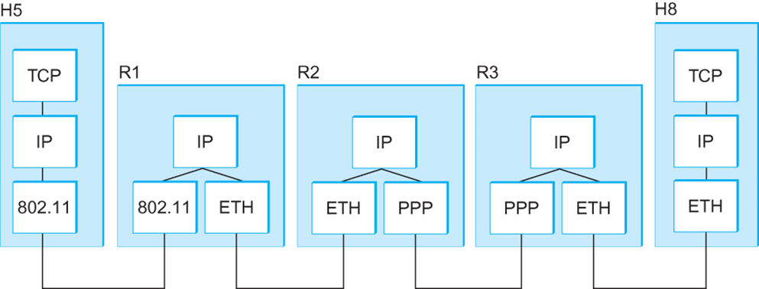

Internetworking
Concatenation of Different Networks
Problem 1: Heterogeneity of Networks
Solution: Layered Protocol Stack (IP over …… )
Problem 2: Scalability in Routing and Addressing
Solution: Address Hierarchy
What is IP?
IP stands for Internet Protocol
Key tool used today to build scalable, heterogeneous internetworks
It runs on all the nodes in a collection of networks and defines the infrastructure that allows these nodes and networks to function as a single logical internetwork

Slide 19
Service Model
A good place to start when you build an internetwork is to define its service model
A service model is the host-to-host services you want to provide
Service model for an internetwork
a host-to-host service only if this service can somehow be provided over each of the underlying physical networks
Two parts
Global Addressing Scheme
Provides a way to identify all hosts in the network
Datagram (Connectionless) model for data delivery
Best-effort delivery (unreliable service)
packets are lost
packets are delivered out of order
duplicate copies of a packet are delivered
packets can be delayed for a long time
Notes:
This service model is sometimes called best effort
although IP makes every effort to deliver datagrams, it makes no guarantees
Datagram
a type of packet sent in a connectionless manner over a network
every datagram carry enough information to let the network forward the packet to its correct destination
no need for any advance setup mechanism to tell the network what to do when the packet arrives
Best-effort delivery (unreliable service)
if something goes wrong and has the following situations
packets are lost
packets are delivered out of order
duplicate copies of a packet are delivered
packets can be delayed for a long time
the network does not make any attempt to recover from the failure

Slide 20
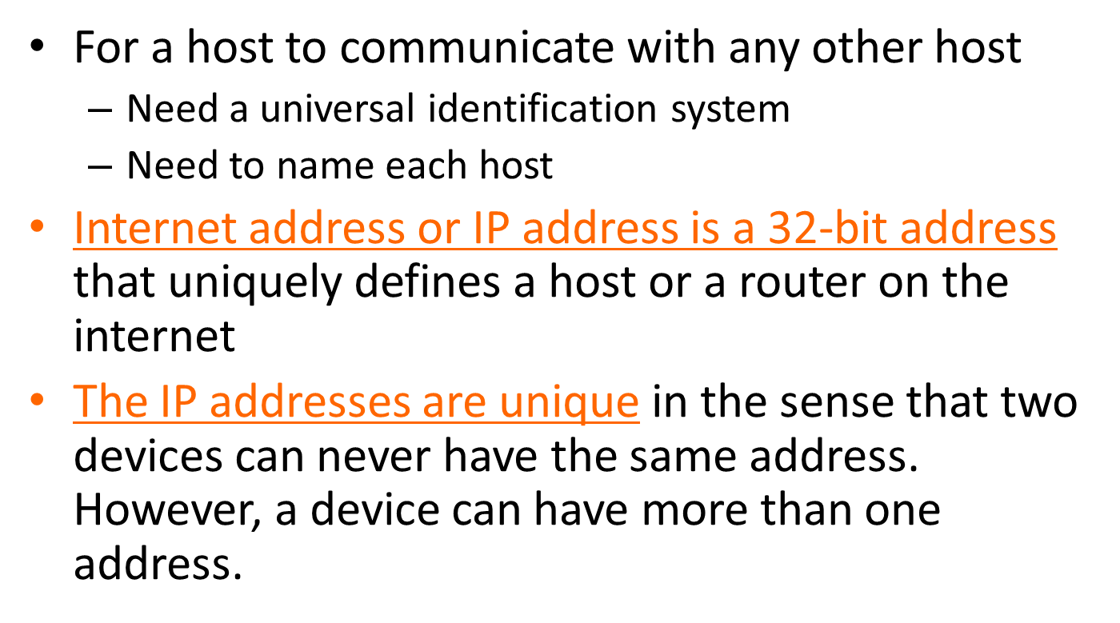
Session 2- Internet Addressing- Introduction

Slide 21
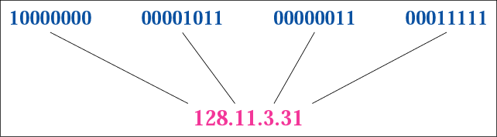
Notation
Ipv4 uses 32 bit address, or a 4 octet address or a 4-byte addresses.
Each connection has a unique address. The address space is 2^32=4,294,967,296(4 billion devices could be connected to the internet)
Binary notation(Base 2 notation)
01110101 10010101 00011101 11101010
Dotted Decimal notation(Base 256 notation)

Slide 22
Notation (cont’d)
Hexadecimal Notation(Base 16 notation)
32 bit address has 8 hexadecimal digits
- Used in network programming
each hexadecimal digit is equivalent to four bits
0111 0101 1001 0101 0001 1101 1110 1010
75 95 1D EA
0x75951DEA

Slide 23
Review Questions
1.Change the following IP addresses from dotted-decimal notation to binary notation.
a. 111.56.45.78 b. 221.34.7.82 c. 241.8.56.12 d. 75.45.34.78

Slide 24
Solution
Replace each decimal number with its binary equivalent:
a. 01101111 00111000 00101101 01001110 b. 11011101 00100010 00000111 01010010 c. 11110001 00001000 00111000 00001100 d. 01001011 00101101 00100010 01001110

Slide 25
Review Questions
2. Change the following IP addresses from binary notation to hexadecimal notation.
a. 10000001 00001011 00001011 11101111
b. 11000001 10000011 00011011 11111111

Slide 26
Solution
Replace each group of 4 bits with its hexadecimal equivalent (see Appendix B). Note that hexadecimal notation normally has no added spaces or dots; however, 0X (or 0x) is added at the beginning or the subscript 16 at the end to show that the number is in hexadecimal.
a. 0X810B0BEF or 810B0BEF₁₆ b. 0XC1831BFF or C1831BFF₁₆

Slide 27
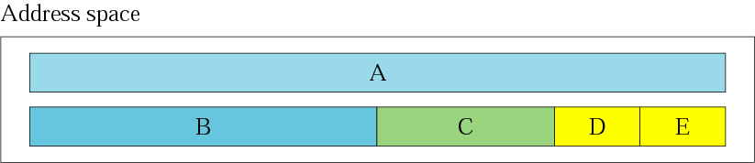
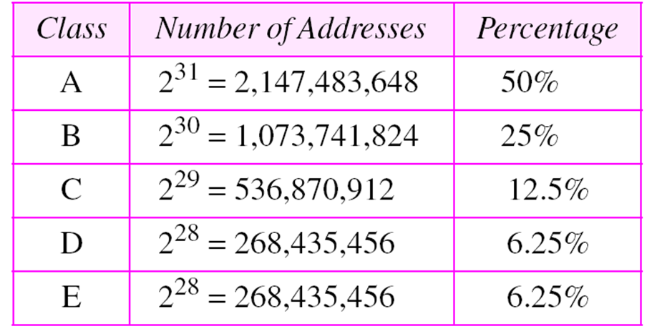

Classful Addressing
Occupation of address space
In classful addressing, the address space(total number of address used by the protocol) is divided into five classes: A, B, C, D, and E.
Class A addresses cover ½ the address space!! Millions of class A addresses are wasted!

Slide 28
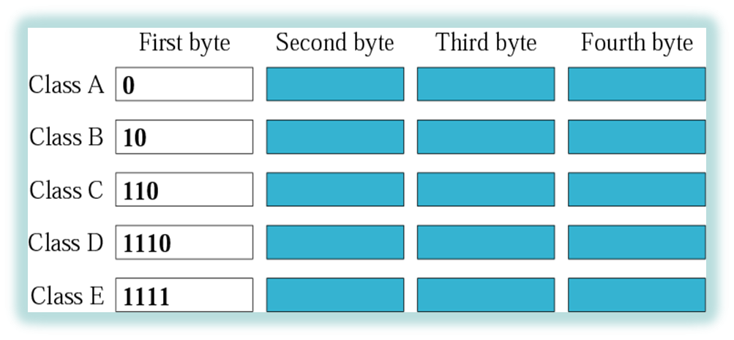
Classful Addressing (cont’d)
Finding the class in binary notation

Slide 29
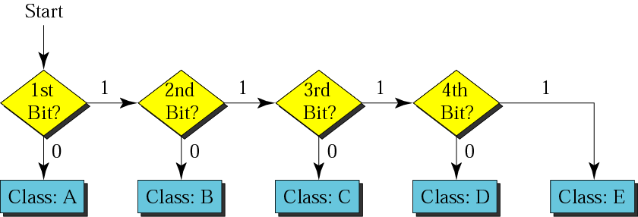
Classful Addressing (cont’d)
Finding the address class

Slide 30
Review Questions
Find the class of each address:
a. 00000001 00001011 00001011 11101111 b. 11000001 10000011 00011011 11111111 c. 10100111 11011011 10001011 01101111 d. 11110011 10011011 11111011 00001111

Slide 31
Review Solution
a. The first bit is 0. This is a class A address.
b. The first 2 bits are 1; the third bit is 0. This is a class C address.
c. The first bit is 0; the second bit is 1. This is a class B address.
d. The first 4 bits are 1s. This is a class E address..

Slide 32
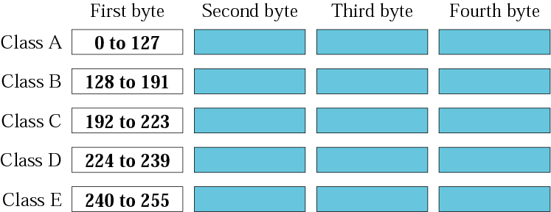
Classful Addressing (cont’d)
Finding the class in decimal notation

Slide 33
Review Questions
Find the class of each address:
a. 227.12.14.87 b.193.14.56.22 c.14.23.120.8
d. 252.5.15.111 e.134.11.78.56

Slide 34
Review Solution
a. The first byte is 227 (between 224 and 239); the class is D. b. The first byte is 193 (between 192 and 223); the class is C. c. The first byte is 14 (between 0 and 127); the class is A. d. The first byte is 252 (between 240 and 255); the class is E. e. The first byte is 134 (between 128 and 191); the class is B.

Slide 35
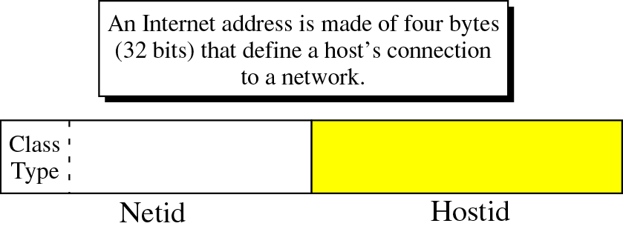
Netid and Hostid
Each IP address is made of two parts; netid and hostid.
Netid defines a network; hostid identifies a host on that network.

Slide 36
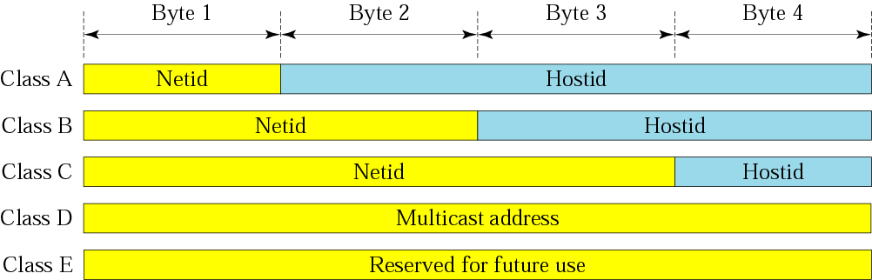
Netid and Hostid (cont’d)
IP addresses are divided into five different classes: A, B, C, D, and E

Slide 37
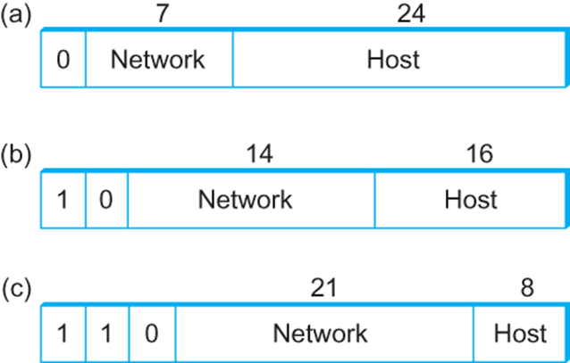
Class A addresses
7 bits for the network part and 24 bits for the host part
126 (= (2^7)-2) class A networks (0 and 127 are reserved)
each network can accommodate up to 2^24-2 (about 16 million) hosts (again, two are reserved values)
Class B addresses
14 bits for the network part and 16 bits for the host part
65,534 (= (2^16)-2) hosts
Class C addresses
21 bits for the network part and 8 bits for the host part
2,097,152 (= 2^{2l}) class C networks
254 hosts (host identifier 255 is reserved for broadcast, and 0 is not a valid host number)
(a) Class A (b) Class B (c) Class C

Slide 38

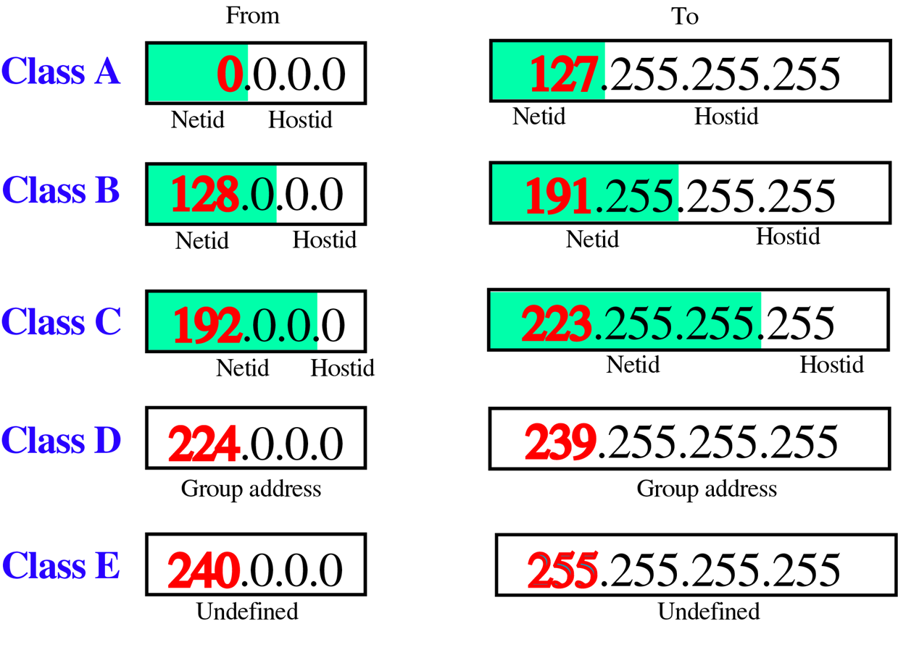

Slide 39
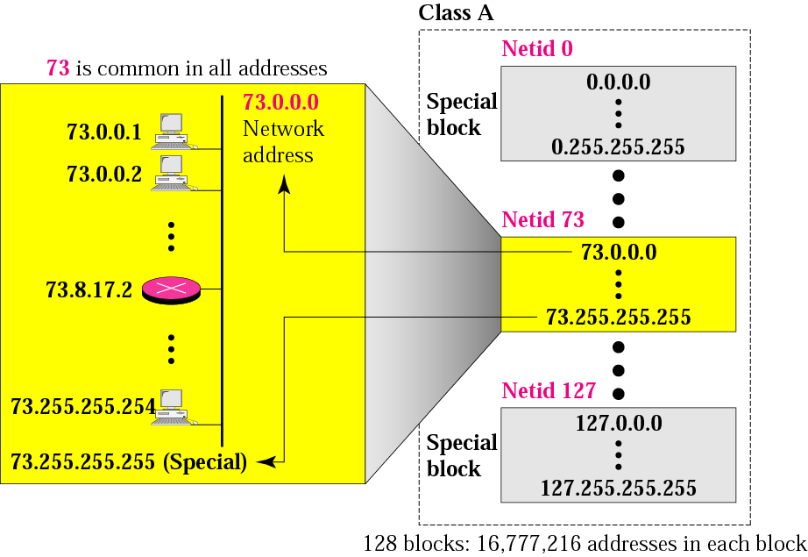
Classes and Blocks
Blocks in class A
Class A is divided into 128 blocks (16,777,216 addresses in each block)with each block having a different netid.
Millions of class A addresses are wasted.

Slide 40
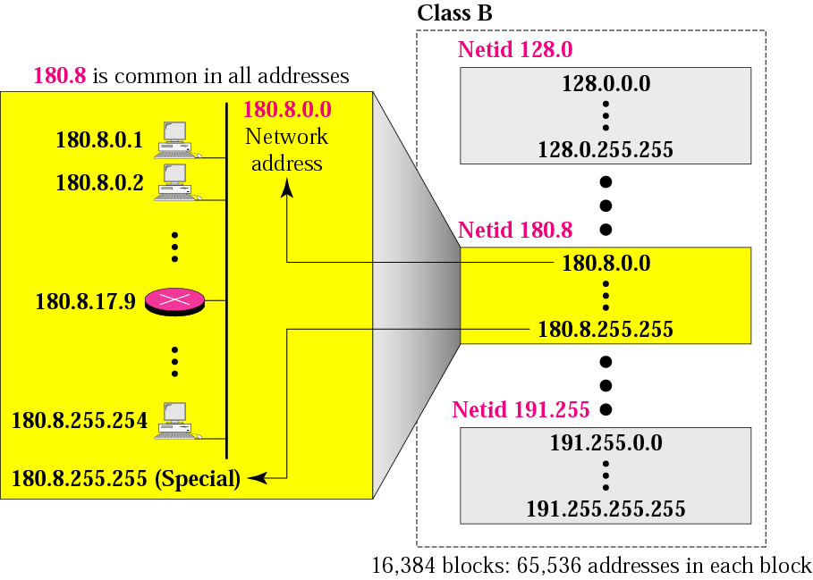
Classes and Blocks (cont’d)
Class B is divided into 16,384 blocks(65536 addresses in each block) with each block having a different netid
Many class B addresses are wasted.

Slide 41
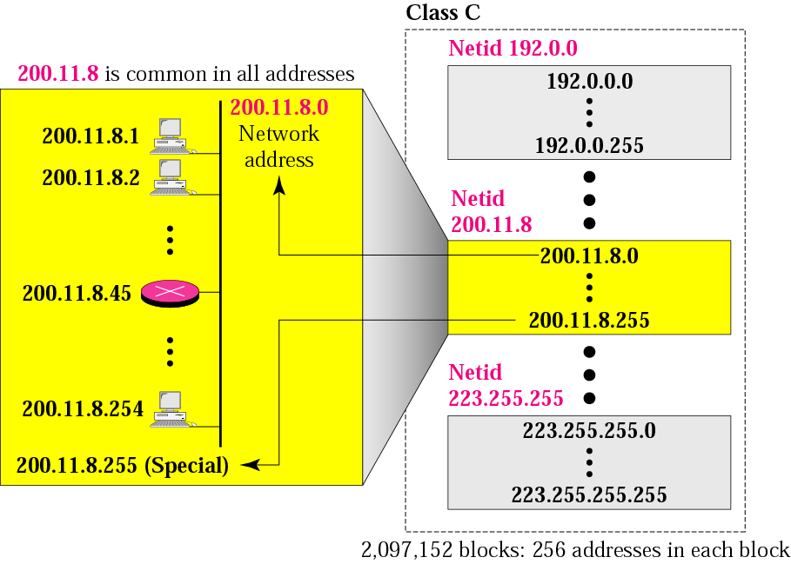
Classes and Blocks (cont’d)
Class C is divided into 2,097,152 blocks (256 addresses in each block)with each block having a different netid.
The number of addresses in a class C block is smaller than the needs of most organizations

Slide 42

Class D addresses are used for multicasting; there is only one block in this class.
Class E addresses are reserved for special purposes; most of the block is wasted.

Slide 43

Note…
In classful addressing, the network address (the first address in the block) is the one that is assigned to the organization.
The network address defines the network to the rest of the Internet.
Given the network address, we can find the class of the address, the block, and the range of the addresses in the block
The range of address can automatically be inferred from the network address

Slide 44
Review Questions:
1.Given the network address 17.0.0.0, find the class, the block, and the range of the addresses.
2. Given the network address 132.21.0.0, find the class, the block, and the range of addresses.
3. Given the network address 220.34.76.0, find the class, the block, and the range of addresses

Slide 45
Solution
The class is A because the first byte is between 0 and 127. The block has a netid of 17. The addresses range from 17.0.0.0 to 17.255.255.255.
The class is B, the block is 132.21, and the range is 132.21.0.0 to 132.21.255.255.
The class is C, the block is 220.34.76, and the range of addresses is 220.34.76.0 to 220.34.76.255

Slide 46
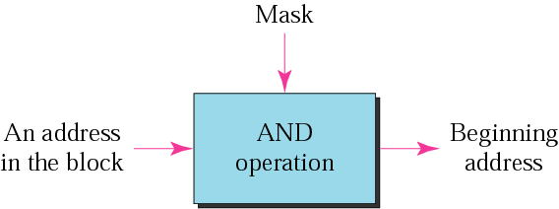
Masking Concept
A mask is a 32-bit binary number that gives the first address in the block (the network address) when bitwise ANDed with an address in the block.
Masking concept: Given an address from a block of addresses, we can find the network address by ANDing with a mask.

Slide 47
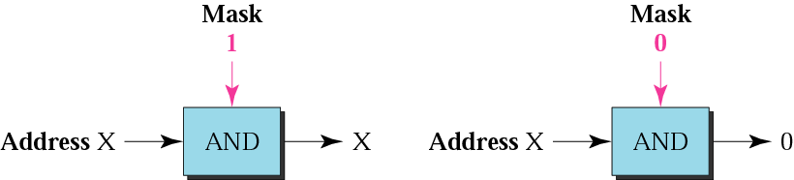
Mask (cont’d)
AND Operation
The network address is the beginning address of each block. It can be found by applying the default mask to any of the addresses in the block (including itself). It retains the netid of the block and sets the hostid to zero.

Slide 48
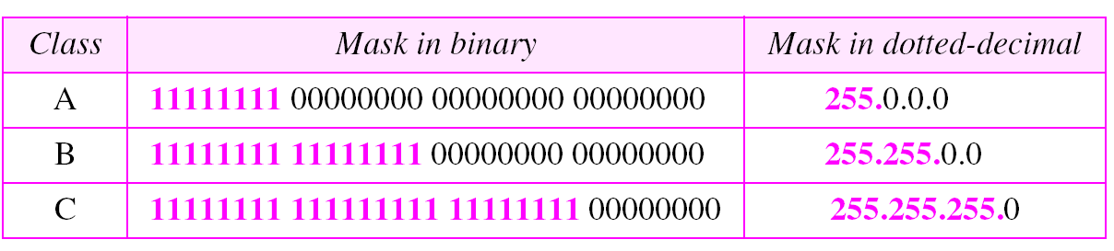
Default Masks
Default masks

Slide 49
Note…
The network address is the beginning address of each block.
It can be found by applying the default mask to any of the address in the block (including itself)
It retains the netid of the block and sets the hosted to zero.

Slide 50
Review Questions:
1.Given the address 23.56.7.91, find the beginning address (network address).
2. Given the address 132.6.17.85, find the beginning address (network address).
3. Given the address 201.180.56.5, find the beginning address (network address).

Slide 51
Solutions:
1.The default mask is 255.0.0.0, which means that only the first byte is preserved and the other 3 bytes are set to 0s. The network address is 23.0.0.0.
2. The default mask is 255.255.0.0, which means that the first 2 bytes are preserved and the other 2 bytes are set to 0s. The network address is 132.6.0.0.
3. The default mask is 255.255.255.0, which means that the first 3 bytes are preserved and the last byte is set to 0. The network address is 201.180.56.0.

